Slide 1
Data visualization using Power BI
Indira Bandari
MICROSOFT DATA PLATFORM MVP
Director, KIDSTECH charitable trust

Slide 2




Indira Bandari Microsoft data platform MVP
Business Intelligence with over 15 years of experience
International speaker, Part time Trainer
Co-organizer for Power BI Meetup and Auckland Artificial Intelligence Meetup
indupriya9@yahoo.com indirabandari Indira-bandari

Slide 3

agenda
What is Power BI ?
Analyse flavors of cocoa
Analyse a quiz challenge
AI in Power BI

Slide 4
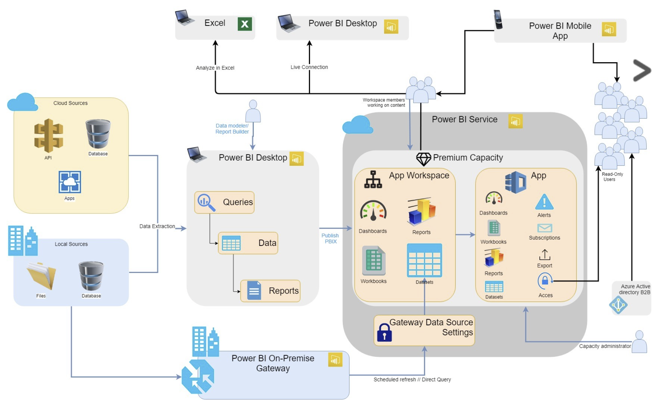
What is Power BI ?

Slide 5
Install power bi desktop
Download from https://powerbi.microsoft.com/en-us/get-started/
A monthly new release with new features
Notes:
Collecting customer feedback shows you value their opinions. By asking your clients forfeedback you communicate that their opinion is important to you. You involve them in shaping your business so they feel more attached to your company. Listening to their voice helps you create stronger relations with them.

Slide 6
power bi desktop – Get Data
How do you get data into Power BI Desktop
Use the GetData button
Notes:
Collecting customer feedback shows you value their opinions. By asking your clients forfeedback you communicate that their opinion is important to you. You involve them in shaping your business so they feel more attached to your company. Listening to their voice helps you create stronger relations with them.

Slide 7
Typical power bi Lifecycle
GET DATA
Location,
Access,
Insert
Update
1
TRANSFORM DATA
Clean data
Change data types
2
CREATE A MODEL
Calculations,
Measures,
Relationships
3
VISUALIZE
Graphs,
Charts,
Slicers
4
PUBLISH
Share,
Refresh,
Deploy
5

Slide 8
Visualiaze flavors of chocolate
Data Source: https://www.kaggle.com/rtatman/chocolate-bar-ratings
Questions/ Report Purpose that can be answered
Number of Chocolates Reviewed by Year
Where are the best cocoa beans grown?
Where are the chocolate companies ?
Which countries produce the highest-rated bars?
What is the best bean_type which will be used to get better cocoa_percent ?
Which Company produced the best rating Chocolate in 2017 ?

Slide 9
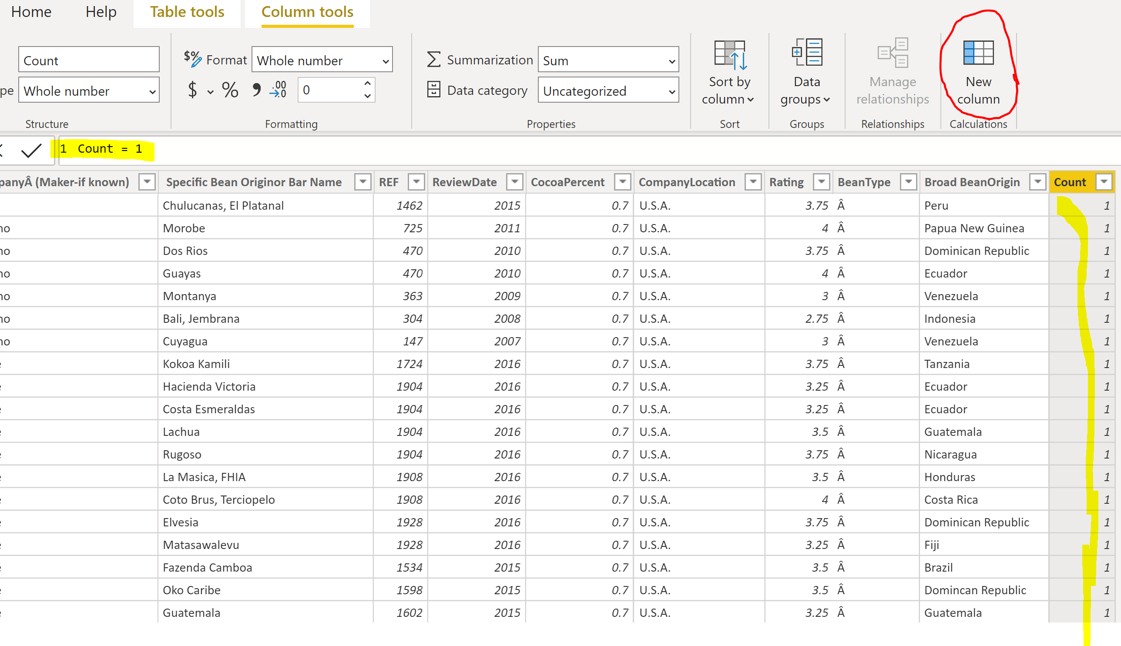
Create a new column

Slide 10
Demo
Open Power BI Desktop
Import flavours of chocolate data into Power BI
Transform the data
Start Visualisations
Go through important features of Power BI

Slide 11
Analyse a quiz challenge
Data Source: Google form that has the Photo Challenge Quiz
Get Data from the responses for this quiz
Transform the data by unpivoting
Create a score column
Determine who is the winner of the challenge

Slide 12
Get Data from google sheet
https://docs.google.com/forms/d/14JMbrkUqa4IS87Z27yGfEB6usKRGYSHxRFDAvhIA1U8/edit
Get shareable link of the Google Sheet
Modify the shareable link and add the following parts:
From:
https://docs.google.com/spreadsheets/d/google-sheet-guid/edit?usp=sharing
To:
https://docs.google.com/spreadsheets/d/google-sheet-guid/export?format=xlsx&id=google-sheet-guid

Slide 13
Report Purpose / Questions
How many people answered each question correctly ?
Who are the top 3 winners?
What were the lowest answered questions ?
What were the highest answered Questions ?

Slide 14
Demo
Open Power BI Desktop
Import flavours of chocolate data into Power BI
Transform the data
Start Visualisations
Go through important features of Power BI

Slide 15
AI Visualisations in power bi
Q&A
Key Influencers
Decomposition Tree

Slide 16

Q & A Feature
Use natural language to ask questions from the data
Eg: Average rating by cocoa percent
Cocoa percent by bean type
Average rating by Review year

Slide 17

Key Influencers
Helps you understand the factors that drive a metric
Eg: What are the factors that influence the Average Rating ?

Slide 18

Decomposition tree
Used when you want to visualise data across multiple dimensions.
Eg: What are the factures that influence the Average Rating ?

Slide 19
RECAP
What is Power BI ?
Analyse flavors of cocoa
Analyse a quiz challenge
AI in Power BI

Slide 20


